Slide 1
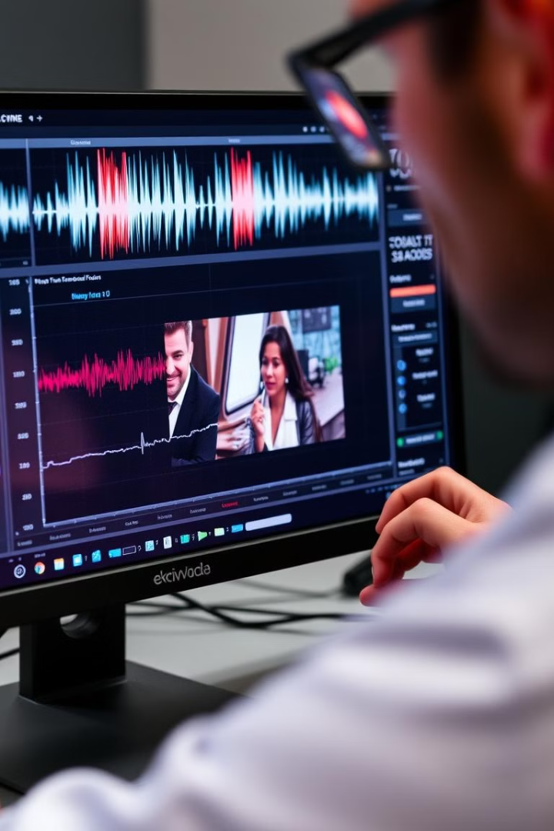
Digital Forensic Video Analysis & Enhancement Techniques
This course introduces you to the fascinating world of digital forensic video analysis and enhancement. You will learn the fundamentals of video analysis, the techniques used to enhance video evidence, and the legal considerations involved. Explore the various stages of video analysis, from acquisition to presentation in court.
Abhinavkumar Yadav
24CO1011
Notes:
1

Slide 2

Introduction to Forensic Video Analysis
1
What is Forensic Video Analysis?
2
Importance in Modern Investigations
Forensic video analysis uses advanced technology to examine video evidence in legal cases.
Video evidence plays a crucial role in investigations, helping to reconstruct events, identify suspects, and establish timelines.
3
Basic Principles and Methodologies
4
Legal Considerations and Chain of Custody
Various methodologies, such as frame-by-frame analysis, enhancement, and tracking, are used to extract valuable information from video evidence.
Understanding the legal aspects and ensuring a proper chain of custody is essential for the admissibility of video evidence in court.
Notes:
2

Slide 3
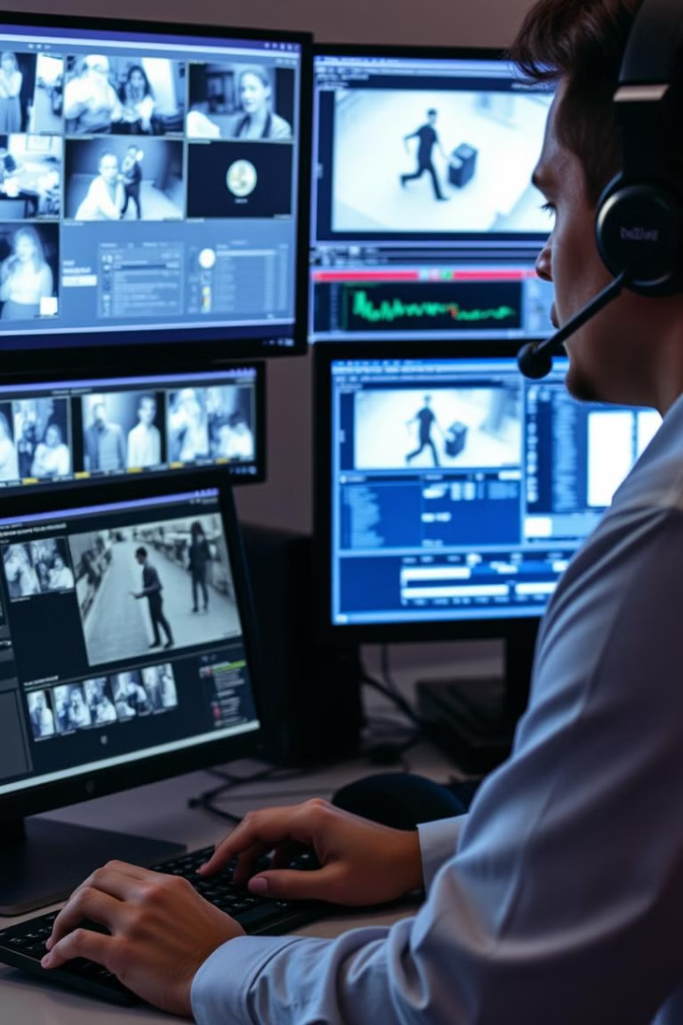
What is Forensic Video Analysis?
Definition
Scope
Forensic video analysis is the scientific examination of video recordings to extract, enhance, and interpret information relevant to legal proceedings.
The scope extends to various applications, including criminal investigations, traffic accidents, surveillance footage, and even personal disputes.
Historical Development
Current Challenges
Video forensics has evolved alongside technological advancements in video recording, processing, and analysis.
New challenges arise with the increasing sophistication of video compression algorithms and the proliferation of high-resolution cameras.
Notes:
3

Slide 4
Importance in Modern Investigations
Reconstruction
Identification
Timelines
Video footage allows investigators to recreate events and understand the sequence of actions.
Video evidence can be crucial for identifying suspects, victims, and witnesses.
Video recordings provide accurate timestamps, establishing the order of events and the time of occurrence.
Notes:
4

Slide 5
Popular Tools
OpenCV
FFmpeg
Amped Authenticate
General-purpose computer vision library.
Features:
-Object detection and tracking.
-Image and video manipulation. -Identifying spliced frames or anomalies.
Purpose: Video processing and analysis.
Features:
-Frame extraction.
-Video format conversion.
-Useful for basic forensic checks like determining if the video has been recompressed.
Detecting forgery and tampering in images and videos. Features:
-Analyzes metadata.
-Identifies traces of editing.
-Compatible with a wide variety of video formats.
Notes:
4

Slide 6
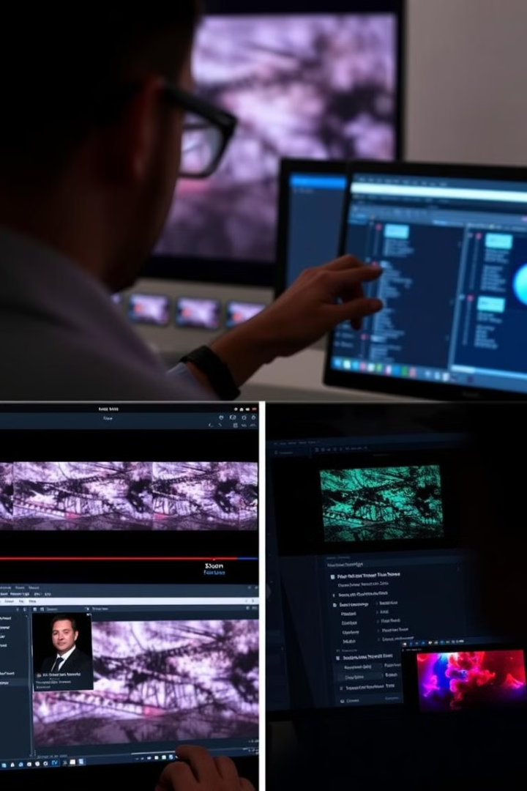
Basic Principles and Methodologies
1
Acquisition
The first step involves acquiring the video evidence, ensuring its integrity and authenticity.
2
Analysis
The video is analyzed frame by frame, with focus on identifying key details and objects of interest.
3
Enhancement
Techniques such as noise reduction, contrast adjustment, and sharpening are applied to improve the clarity of the video.
4
Interpretation
The enhanced video is interpreted, with experts providing insights and drawing conclusions from the analysis.
Notes:
5

Slide 7





Legal Considerations and Chain of Custody
Admissibility
Video evidence must meet legal standards to be admissible in court.
Chain of Custody
A documented chain of custody ensures the integrity and authenticity of the video evidence.
Authentication
The source of the video must be verified and authenticated to ensure its legitimacy.
Expert Testimony
Experts in video analysis may be called upon to provide testimony regarding the findings and interpretation of the evidence.
Notes:
6

Slide 8
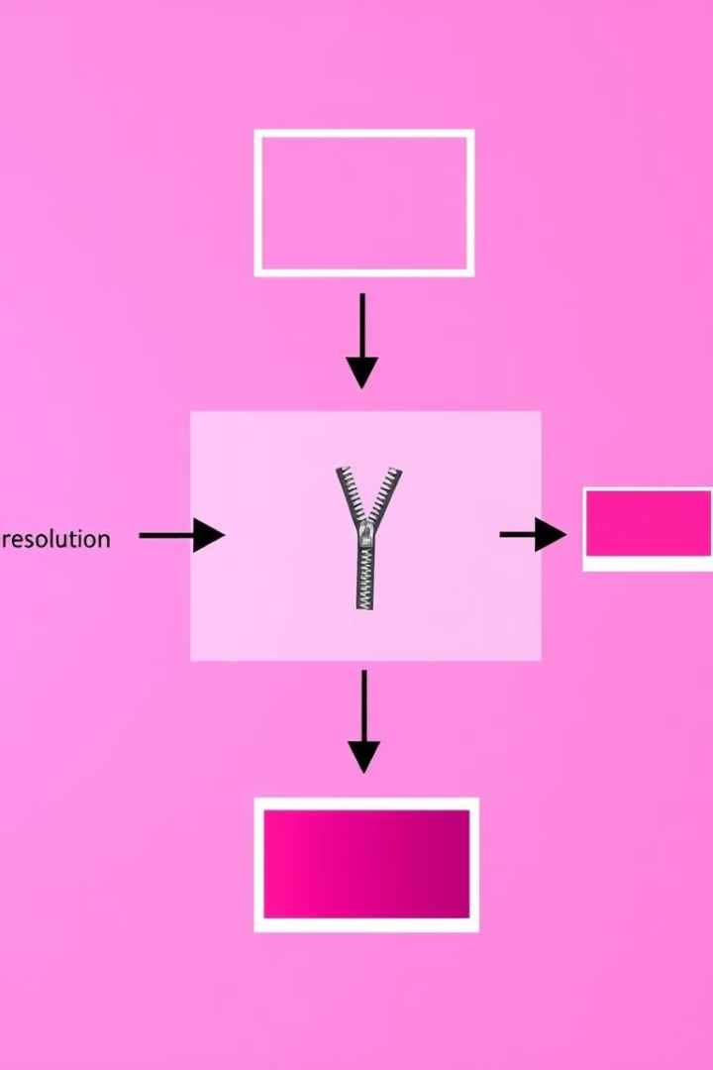
Digital Video Fundamentals
Frame Rate
Number of frames displayed per second, influencing the smoothness of motion.
Resolution
Number of pixels in the video frame, determining the sharpness and detail.
Compression
Technique used to reduce file size, balancing quality with storage efficiency.
Color Space
Range of colors represented in the video, influencing its appearance and accuracy.
Notes:
7

Slide 9
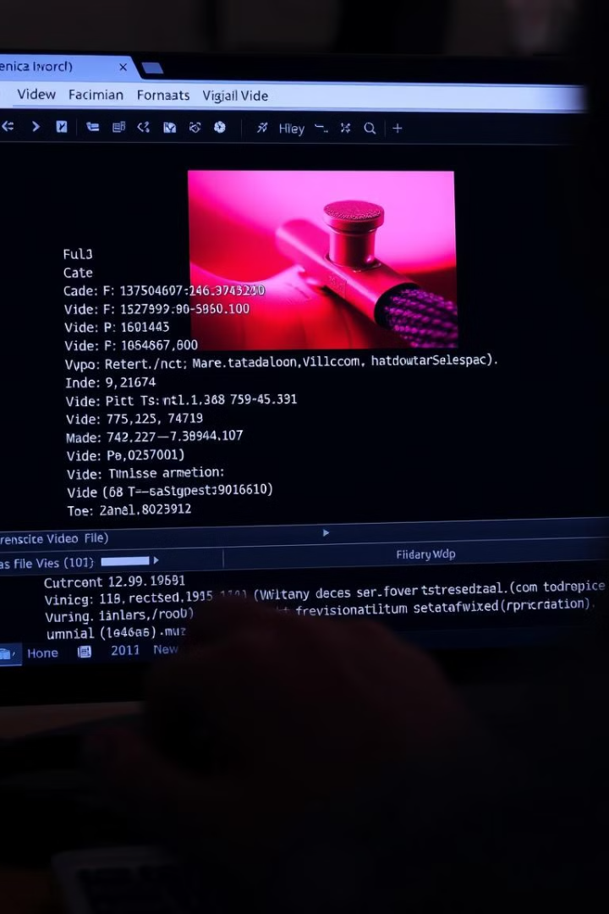




Video Formats and Codecs
Format
Codec
Defines the structure and organization of the video data, such as AVI, MP4, or MOV.
Compression and decompression algorithm used to encode and decode the video data.
Metadata
Resolution
Information embedded within the video file, including recording date, camera model, and other details.
The number of pixels in the video frame, affecting the clarity and detail.
Notes:
8

Slide 10
Video Formats and Codecs
Frame-by-Frame Analysis
Motion Stabilization
Extract specific frames for detailed inspection
Reduce the effects of camera shake or jitter
Resolution Enhancement
Color Enhancement
Improve the clarity of low-resolution video.
Correct color balance or enhance specific colors
Notes:
8

